Slide 1
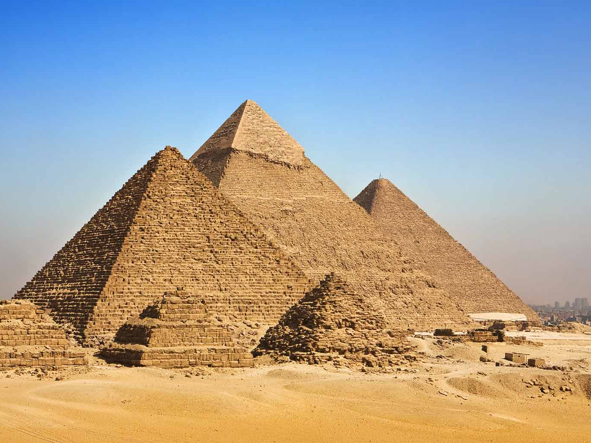
Let’s Review - Pyramid
Concept 10
Concept 8
Concept 9
Concept 5
Concept 6
Concept 7
Concept 1
Concept 2
Concept 3
Concept 4
Notes:
Play the game to help review.
User note: Add specific vocabulary or key concepts in each block of the pyramid.
Explain how the Pyramid Review works.
1’s face the screen and 2’s turn their backs.
1’s will give clues for the partner to guess the words on the screen moving across each level and then to the top.

